Slide 1
Cisco+ Secure Connect
A Unified SASE Solution powered by #OneCisco
January 2023
Notes:
Enable your hybrid workforce with a experience

Slide 2
Challenges faced today
Why SASE Is the Answer
Cisco+ Secure Connect
Charting your path to SASE
Why Cisco SASE
Q&A

Slide 3
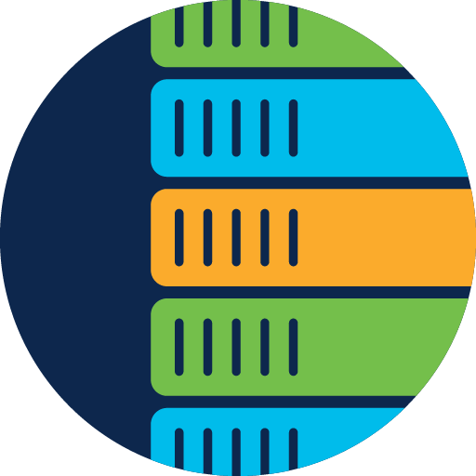
Changes that led to SASE Cloud revolution and hybrid work
SaaS
Cloud applications exploded, but traffic was still routed through the central firewall at the data center.
SAP
Oracle
G Suite
Public cloud
Internet
Private cloud
Adobe
Office 365
Salesforce
Branch security was redesigned differently at each site, leading to inconsistent security policies.
Remote workers connecting through regional VPNs introduced stress points, resulting in poor user experience.
Data center
MPLS
MPLS
45%
Branch offices
Branch offices
Site-to-Site
Site-to-Site
Campus
of business respondents cited reliable network performance as the #1 challenge for hybrid work adoption².
Client VPN
Client VPN
Client VPN
2: Gartner survey of 500 enterprise businesses. Gartner Market Guide for Digital Experience Monitoring, August 2020
Remote workers
Notes:
Businesses moved applications from the data center to the cloud and Internet traffic shot up 8x to 10x almost overnight. But traffic was still routed through the central firewall at the data center, creating bottlenecks and “hairpinning” traffic.
***CLICK***
As networks grew, the distributed model meant different IT teams in different geographies. Each branch was managed independently leading to inconsistent security policies. Users were inconvenienced and systems had vulnerabilities.
***CLICK***
An explostion of Remote workers connecting through regional VPNs introduced stress points resulting in a really poor user experience both for remote workers, as well as those in the office.
***CLICK***
The result is that business are struggling with performance and need a solution in order to adopt hybrid work.
IT Admins cited reliable network performance as the #1 challenge with hybrid work adoption
*: Gartner survey of 500 Enterprise businesses. Gartner Market Guide for Digital Experience Monitoring, August 2020
Highlight something that has changed dramatically. The usage of applications outside of the corporate firewall has increased by X%
X% of people bring their own device to work (remote or not)
X% of businesses said that network security is #1 concern.

Slide 4
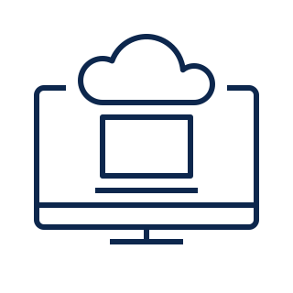
With the pace of change accelerating…
Secure connectivity challenges are outpacing human scale and skills
Hybrid work is the norm
Transition to multicloud and SaaS
Remote users
Web
Ever-expanding connections
Corporate IT
Personal and
mobile devices
Public SaaS apps
Ever-expanding attack surface
IoT devices
Private apps
Notes:
The complexity of network security is being driven by two key trends:​
The hyper-distribution of people, places, and things as more organizations embrace hybrid work, where users are accessing corporate resources via company-owned devices (managed devices) and personal devices (unmanaged devices), and where organizations are deploying more Internet of Things (IoT) devices as part of automation and operational technology (OT) initiatives​
And the shift to cloud and software-as-a-service (SaaS), which continues to gain pace as organizations look to be more agile and resilient in the face of disruption, and has resulted in the hyper-distribution of applications and data across public, private, and hybrid clouds​
These trends present two key challenges: ​
You need a smarter way to manage multicloud connectivity​
And a smarter way to protect against smarter attackers ​

Slide 5
And at every turn in the experience…
More and more blind spots
Hybrid work is the norm
Transition to multicloud and SaaS
Remote users
Web
Personal and
mobile devices
Public SaaS apps
IoT devices
Private apps
Notes:
Supporting hybrid and remote workforce experiences is difficult because IT teams have limited control over, and visibility of the complete service delivery chain:​
With so much reliance on the Internet and cloud services, there are more networks outside of your IT team’s ownership or direct control​
Your IT team needs visibility, but everything outside your environment represents a potential blind spot​
When an issue arises, it can really difficult to pinpoint where the problem is coming from - it could be the service provider, an application, an edge service — and you just don’t know​
And it takes an incredible amount of time and resources just to determine the problem — if you’re able to find the problem at all!​
So, where do we go from here?

Slide 6
How can IT get ahead?
The Answer
SASE
Notes:
IT teams need a new way to achieve secure connectivity and assure the application experience when users are working from… well… anywhere…
The answer? SASE
A strategy converging software-defined networking and security all managed and delivered from the cloud
The goal is to provide a more consistent architecture that is easier to manage, more dynamic and more secure than how it’s been done up until now

Slide 7
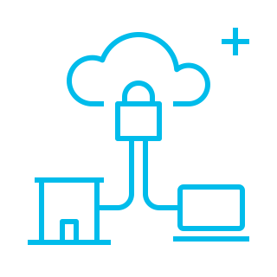
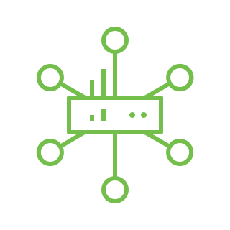
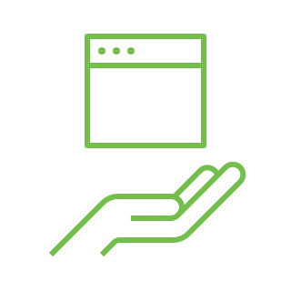
What is Secure Access Service Edge (SASE)?
Network as a service
Network security as a service
Connect It
Secure It
Market convergence
SASE
Secure SD-WAN Fabric*
Performance-based Internet Routing
Cloud Access Security Broker (CASB)
Zero Trust Network Access (ZTNA)
On-prem Unified Threat Management
On-ramp into Public IaaS and Private Cloud*
SD-WAN Analytics (including Internet Intelligence)
Firewall as a Service (FWaaS)
Secure Web Gateway (SWG)
SD-WAN
SSE
*with support for remote workers
Notes:
So, what is SASE?
SASE is a term coined by Gartner in 2019
It stands for Secure Access Service Edge
SASE requires little to no hardware and employs cloud technology to combine SD-WAN with network security functions.
SD-WAN: Performance based internet routing; on-prem unified threat management; on-ramp into public and private clouds; analytics
SSE (Secure Service Edge): Firewall as a service (FaaS); Secure Web Gateways; Cloud Access Security Brokers (CASBs); Zero-Trust Network Access
The combination of SD-WAN and SSE is SASE

Slide 8
Why SASE?
1
Reduce operating cost
2
Cisco and Pulse surveyed 100 technology executives to find out what they hope to accomplish with SASE:
Support hybrid and remote workforce experience
3
Reduce and mitigate risk
© 2022 Cisco and/or its affiliates. All rights reserved. Cisco Confidential
Notes:
What can you expect to accomplish with SASE?
Reduce cost by avoiding technical debt, with little to no hardware to procure we can improve OpEx and simplifying operations.​
Improve the user experience, which means providing a seamless and secure connection any where the user works from, accelerating time to market, and being able to scale with confidence​
Minimize risk by assuring advanced security, end-to-end visibility, and working with a partner who has a robust vision and product roadmaps​ for an ever-evolving world

Slide 9
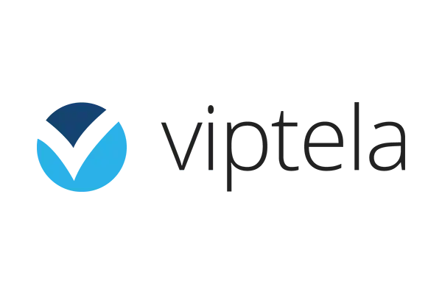
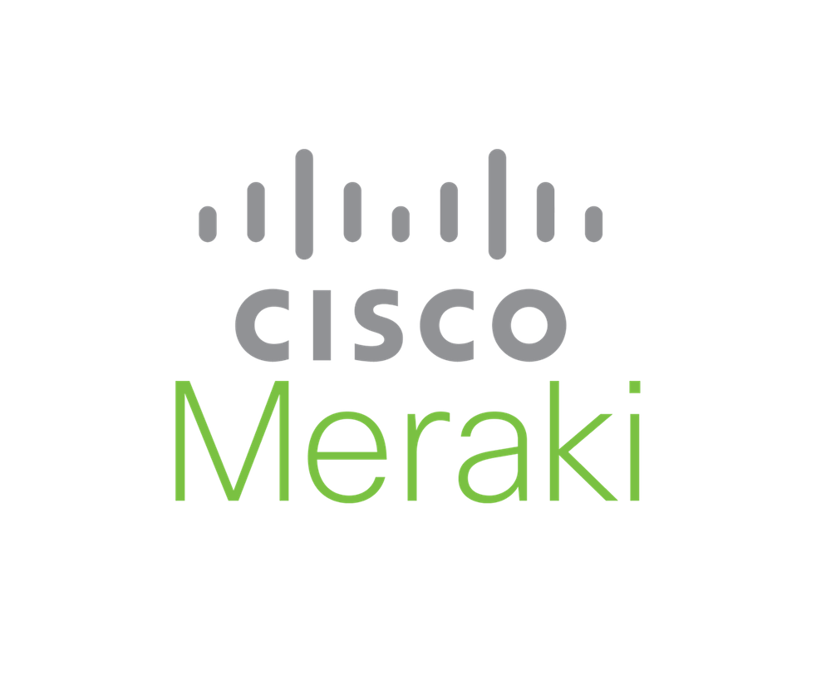
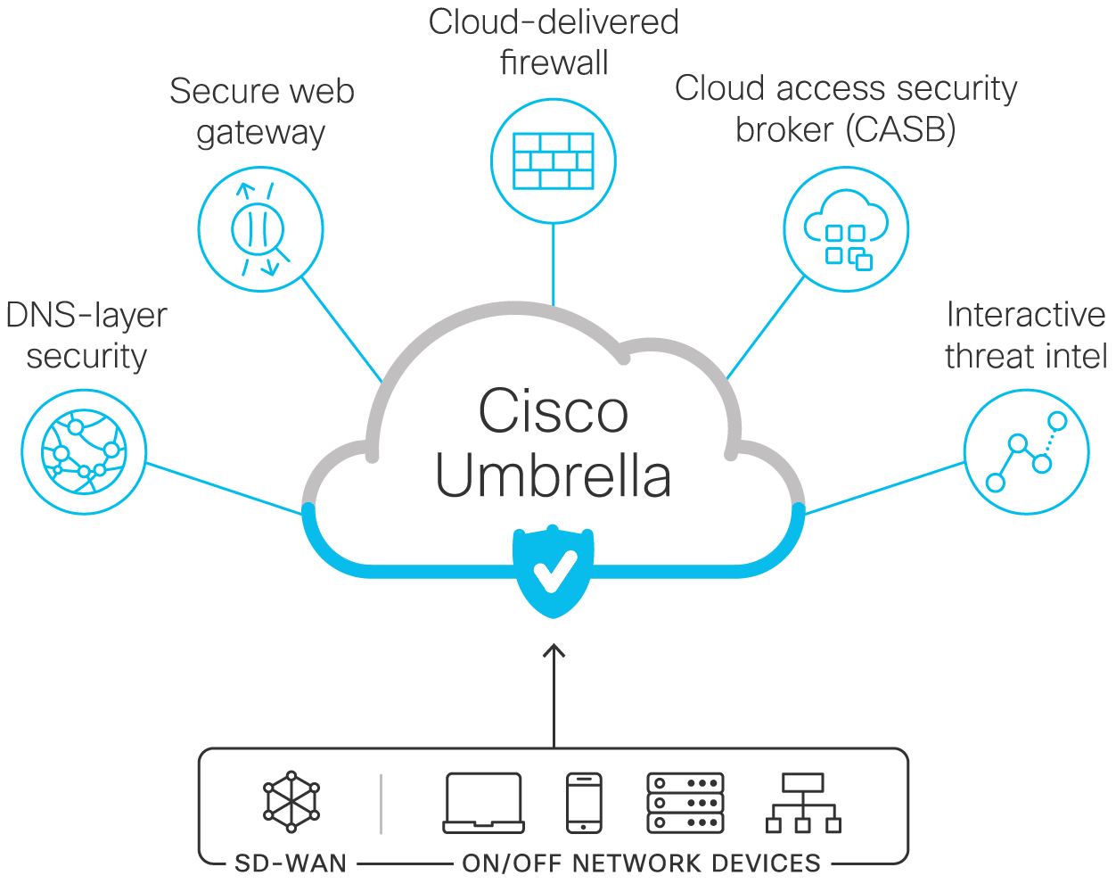
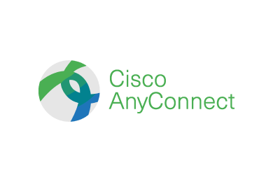
Which tools are already at our disposal?
Notes:
Benefits of each tool
- Meraki
Umbrella
AnyConnect
Viptella
Problems with current tools
All Separate products - multiple dashboards to manage - renewal dates to track – extra cost for support – different numbers to call
Multiple teams involved (NetOps/SecOps)
Security Gaps

Slide 10
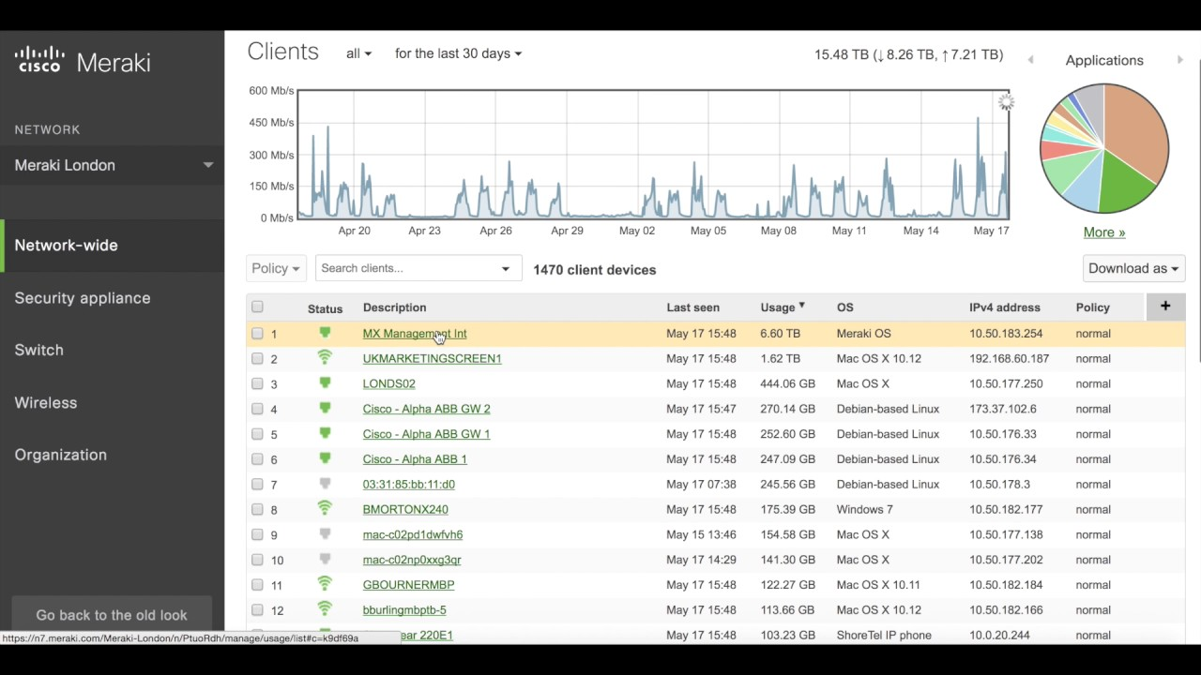
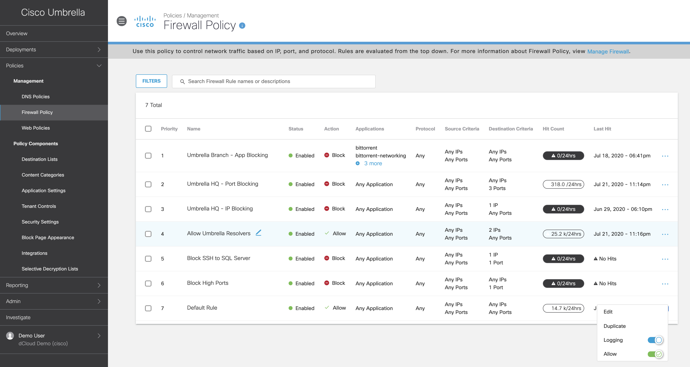
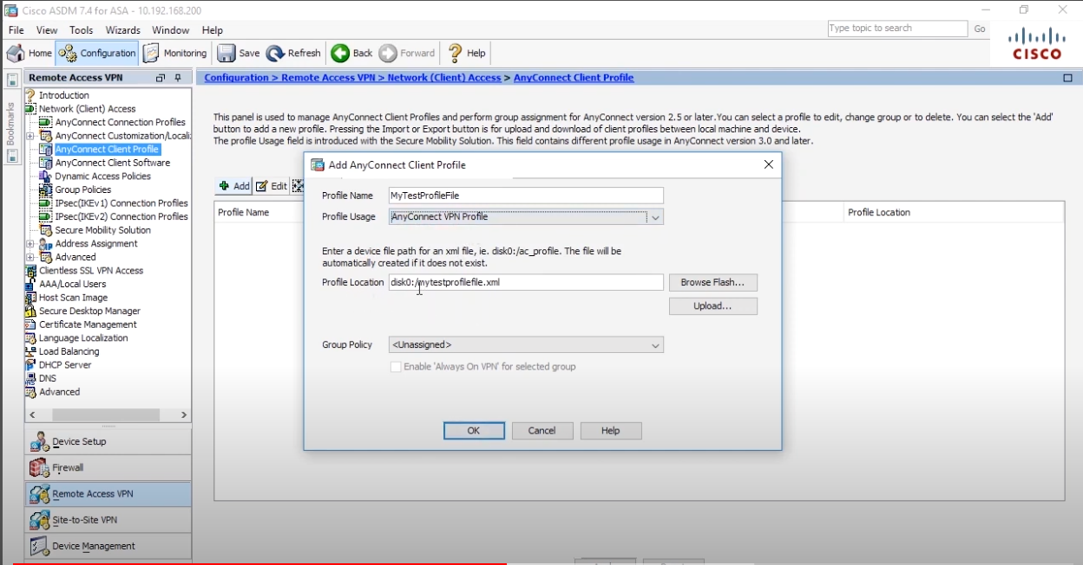
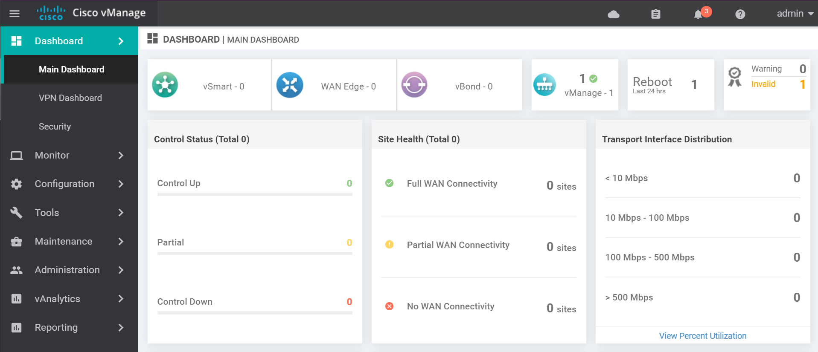
Which tools are already at our disposal?
Notes:
Benefits of each tool
- Meraki
Umbrella
AnyConnect
Viptella
Problems with current tools
All Separate products - multiple dashboards to manage - renewal dates to track – extra cost for support – different numbers to call
Multiple teams involved (NetOps/SecOps)
Security Gaps

Slide 11
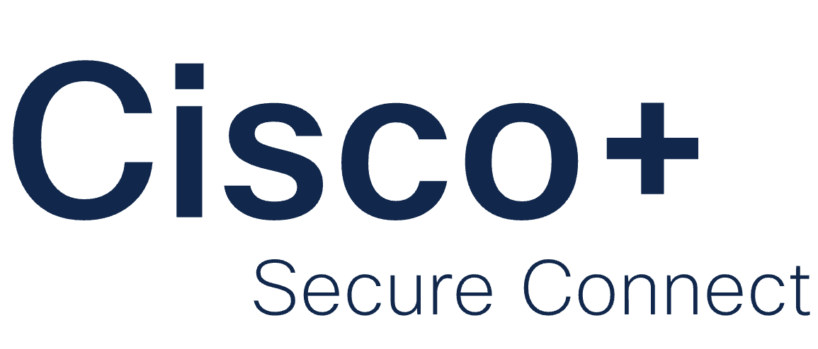

Slide 12
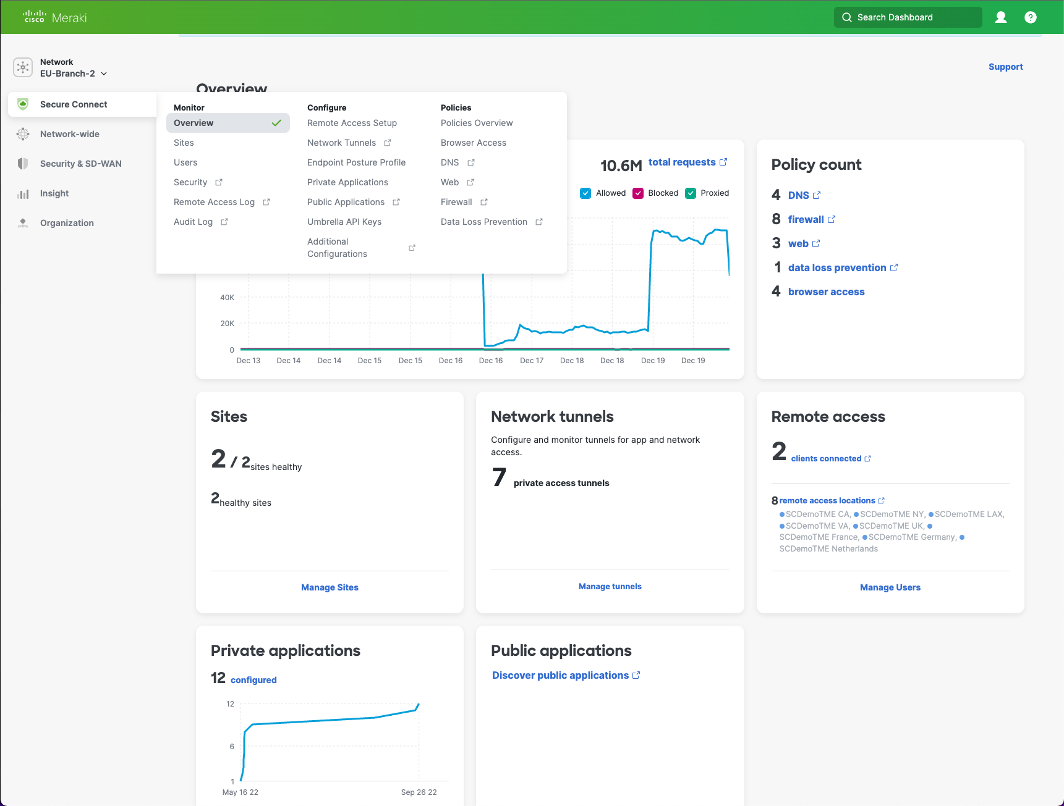
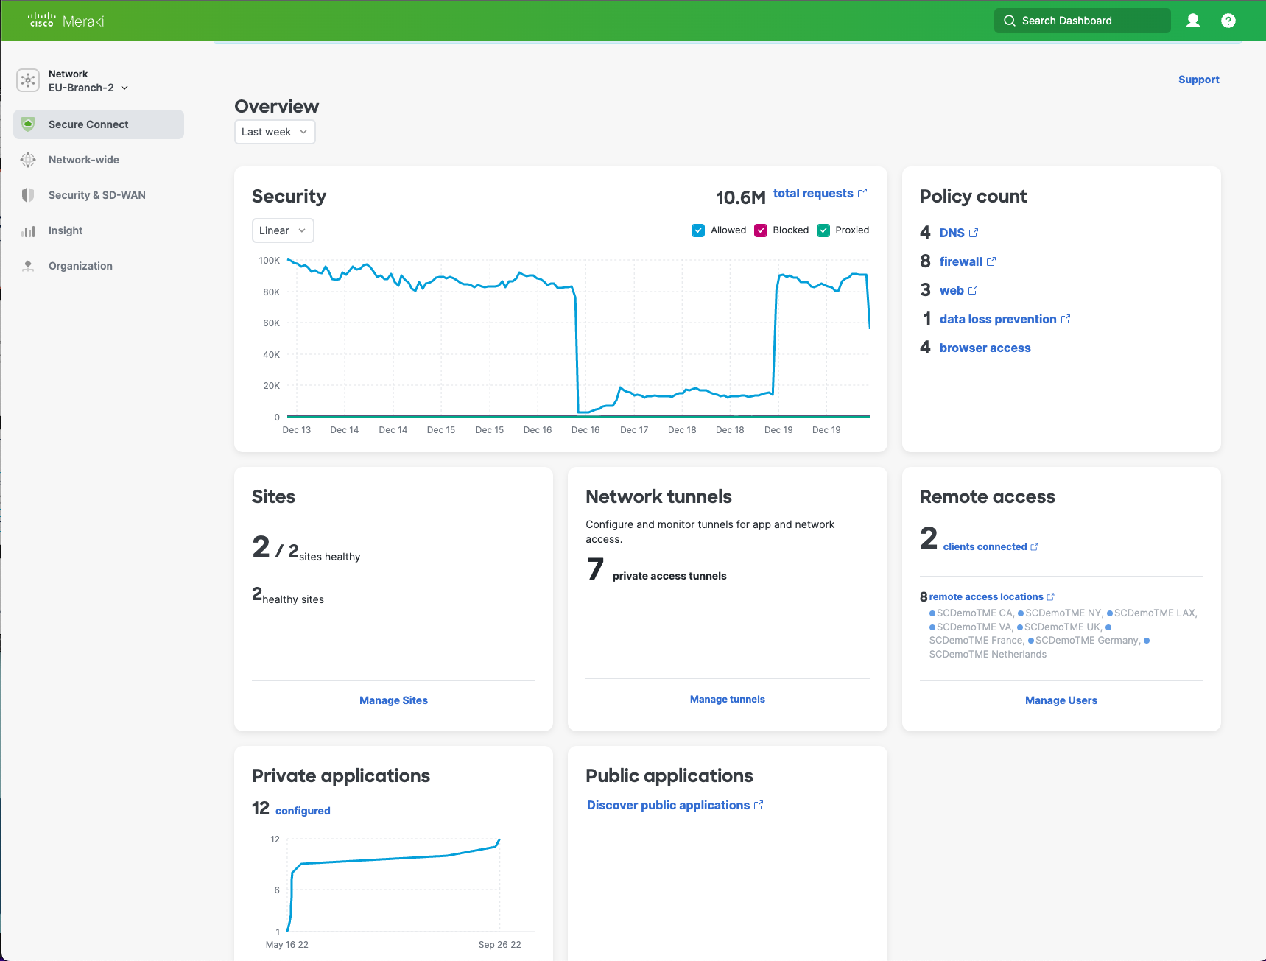
Notes:
Managed under a single pane of glass inside the Meraki Dashboard
Support is included One phone number to call (Secure Connect support)
One renewal to manage – Pay as you grow (per user per year)
Automatic updates Simple - single dashboard - centralized policies - Single renewal
Add users as you grow - Flexible terms (monthly, yearly, up front)
Interconnected - Interoperable - Always up to date
- Less expensive bundling together - little to no hardware to maintain
Support included 24x7

Slide 13
A single, powerful platform
Cisco+ Secure Connect
DNS-layer
security
Secure web gateway
Cloud-delivered firewall (w/ IPS)
Cloud access security broker
Remote Access
Interactive threat intelligence
File
Sandboxing
Data
loss
prevention
Cloud malware detection
ZTNA Browser-based access
SecureX
SD-WAN
ON/OFF NETWORK DEVICES
Integrated security platform
Notes:
Unified dashboard
Single SKU
Single renewal
Easy to manage
Support included 24x7
Less expensive bundling together little to no hardware to maintain
Add users as you grow
Opposite of these: Negatives
Slow & difficult to manage (inconsistent)
If breached, access to everything
Maintenance and refreshes are expensive
Mis-sizings
Inferior IT/End user experience
Negatives
Change is scary & uncomfortable
Existing solutions make transformation difficult
Finding trusted vendors
Is security up to your standards?

Slide 14
Cisco+ Secure Connect Your blueprint for SASE made easy
Resilient Network Security
People
Build greater resiliency and agility with continuous visibility into threats and better protect your users and your business
Secure Hybrid Work
Safely connect users across any point of service for secure access to empower remote work
Applications
Things
Cisco+ Secure Connect
Unified IT Experience
Deliver an exceptional, seamless experience that is easy to deploy and operate, without complex engineering
Security
Visibility
Seamless Path to SASE
Confidently navigate your SASE journey without the complexity, all powered within a single platform
Networks
Notes:
Built for speed and simplicity, Cisco+ Secure Connect is the premier single-vendor solution with a blueprint for SASE made easy that helps to build greater network resiliency and secure hybrid work, delivers a single, unified IT experience, and provides an easy, seamless path to SASE.
Build resilient network security:
Build greater network security and resiliency
Achieve improved security posture with continuous visibility into threats
Be agile in response to unpredictable events
Create a dynamic and resilient network environment to protect users and your business
Secure a hybrid workforce:
Secure a hybrid workforce
Safely connect across any point of service for secure access
Improve employee productivity and empower hybrid work
Confidently trust in the power of Cisco Meraki that supports over 4M unique networks globally and connected to hundreds of millions of client devices
Deliver a unified IT experience:
Provide a single, streamlined user experience
Deploy SASE in as little as 2 hours without complicated engineering*
Onboard remote workers up to 10x faster*
*based on public customer success story feat. George Sink Law
Forge an easy, seamless path to SASE:
Confidently navigate the SASE journey without the complexity
Converge networking and security to create a unified experience that is managed within a single platform
Benefit from as-a-service consumption model that provides economic value add (shift from CapEx to OpEx)

Slide 15
Notes:
Journey
Limitations currently
Geos
EAs
Niche features (RBI, reserved IP, Always on VPN, etc)
Early adopters
Take the journey with us
One geo at a time
Start with Remote Users only
Etc.
Help us build

Slide 16
Robust, all-in-one turnkey solution
Seamless, secure access to any application from any device or location
Single subscription adaptable to business needs
Cloud-delivered, streamlined security and network capabilities with unified visibility
Global cloud footprint with rock-solid reliability and lightning-fast performance
Future: Premium services and extensibility to full network-as-a-service stack
Internet
Public/Private clouds
SaaS
Cloud dashboard, end-to-end application observability, APIs
Security
Network
Observability
Global cloud footprint
Remote access
SD-WAN
Notes:
If you take this journey with us, we will arrive at the promised land together. Our aim is to deliver seamless, secure access to any application from any device or location with a single subscription that you can pay for as you grow. All security and network capabilities are delivered from the cloud in a unified dashboard giving your organization a global footprint with 99.99% uptime SLA and eventually more premium services and extensibility to a full Network as a Service stack.
Promise land
Available in all Geos
Niche features added in (reserved IP, Always on VPN, RBI, etc)
Single pane of glass
Visibility
Manageability
Seamless end user experience
Higher productivity
Happier employees
Fewer headaches
More secure
Plenty of support as challenges arise
More features coming as this architecture evolves

Slide 17
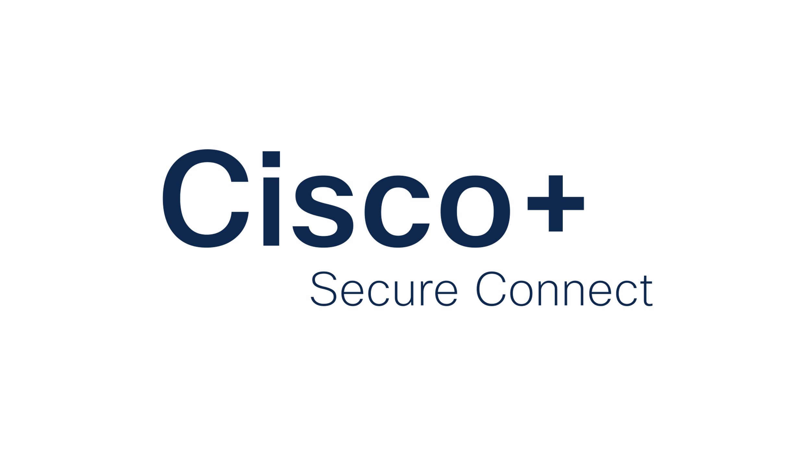
Driving outcomes for your business
Enable hybrid workforce with a single solution for consistent access and user experience
Increase worker productivity with connectivity anywhere and improved application performance
Lower overall IT spend with a simple subscription model and pay as you grow
Reduce security risk and maintain your security compliance requirements
Your blueprint for SASE, made easy
Notes:
Cisco+ Secure Connect offers a simple IT experience by making it easy to deploy, scale, and secure access to applications with a pay-as-you-grow, as-a-Service model. This enables organizations to manage both private and public access with a single solution for consistent access and user experience without any increase to CAPEX or IT resources. Business outcomes include:
Enable hybrid workforce and deliver an optimized end-user experience, increasing worker efficiency and productivity.
Best-in-class security services provide unparalleled security and protection against ransomware and hacking.
Shift budget to Opex so IT Admins do not need to plan 10 years ahead; they can scale as they go
IT Admins can focus on business value and innovation instead of ongoing routine IT tasks thanks to simplified UI, architecture and aaS automation
This is our blueprint for SASE, made easy for organizations like yours. I’d love to know your thoughts.
After all you’ve heard about here today, What stands out to you most?

Slide 18
Thank you
Notes:
Where should we go from here?

